Slide 1
Types of Datasets
DSC – Class – 1.2

Slide 2
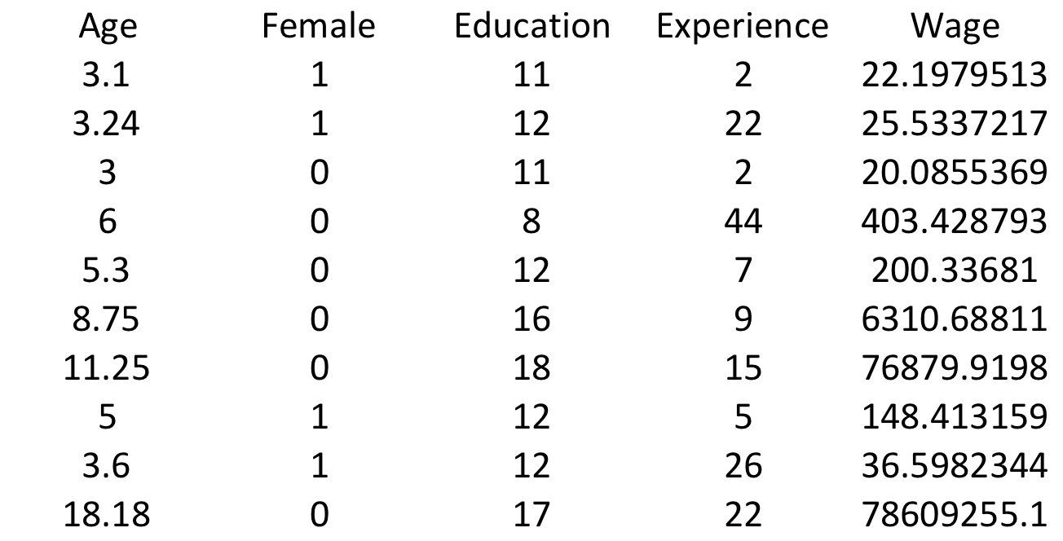
Cross-Sectional
Recordings of several individuals collected on a single time period or the recordings are not time dependent
To model the variation in wage among individuals

Slide 3
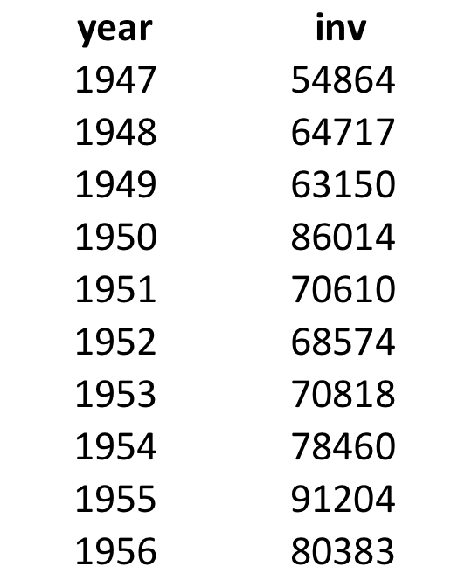
Time Series
Recordings of one individual collected on several time periods. In other words, chronological data points
To model the variation in housing investments across the years

Slide 4
Panel or Longitudinal
Recordings of several individuals collected on several time periods
To model the variation among individuals and also across the time periods

Slide 5
Panel or Longitudinal
Question: Suppose that a cross-sectional sample of married women is found to have an average yearly labor-force participation rate of 50%. Interpret this result in your words.
1. It might be interpreted as implying that each women in a homogeneous population has a 50% chance of being in the labor force in any given year
2. It might imply that 50% of the women in a heterogeneous always work and other 50% never work
What is missing?
Individual labor-force histories (the time dimension) to estimate the probability of participation in different subintervals of life cycle

Slide 6
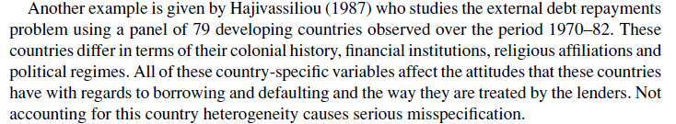
Panel or Longitudinal

Slide 7
Types of Studies

Slide 8
Observational
A study on observations collected from individuals by interviewing directly or indirectly
Example: All the above examples

Slide 9
Experimental
A study on observations collected from individuals after applying a treatment
Example: Studying the affect of a drug/treatment on patients

